Slide 2
METTS
S. R. White, Minimally Entangled Typical Quantum States at Finite Temperature, PRL 2009;
minimally entangled typical thermal states

Slide 3
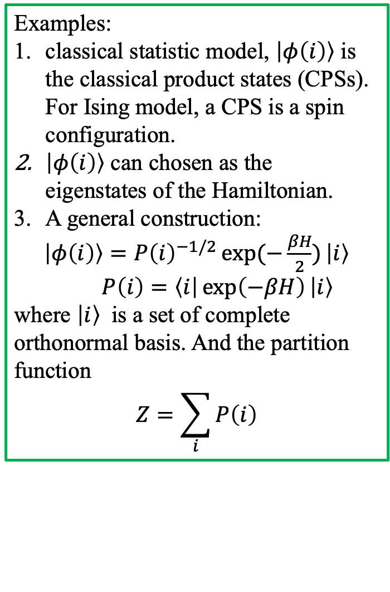
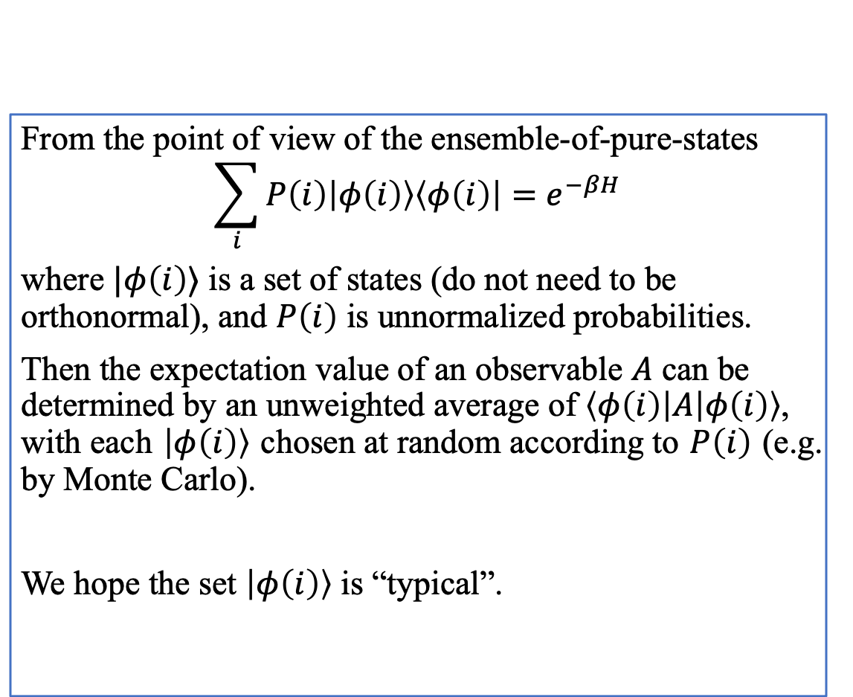
From the point of view of the ensemble-of-pure-states
$$\sum_{i}{P\left(i\right)\left|φ\left(i\right)\right\rangle \left\langle φ\left(i\right)\right|}=e^{−βH}$$
where $|φ\left(i\right)⟩$ is a set of states (do not need to be orthonormal), and $P\left(i\right)$ is unnormalized probabilities.
Then the expectation value of an observable $A$ can be determined by an unweighted average of $\left\langle φ\left(i\right)\right|A\left|φ\left(i\right)\right\rangle$, with each $\left|φ\left(i\right)\right\rangle$ chosen at random according to $P\left(i\right)$ (e.g. by Monte Carlo).
We hope the set $\left|φ\left(i\right)\right\rangle$ is “typical”.
Examples:
classical statistic model, $\left|φ\left(i\right)\right\rangle$ is the classical product states (CPSs). For Ising model, a CPS is a spin configuration.
$\left|φ\left(i\right)\right\rangle$ can chosen as the eigenstates of the Hamiltonian.
A general construction:
$\left|φ\left(i\right)\right\rangle =P{\left(i\right)}^{−1/2}\exp{(−\frac{βH}{2})}\left|i\right\rangle$ $P\left(i\right)=\left\langle i\right|\exp\left(−βH\right)\left|i\right\rangle$
where $\left|i\right\rangle$ is a set of complete orthonormal basis. And the partition function
$$Z=\sum_{i}{P\left(i\right)}$$

Slide 4
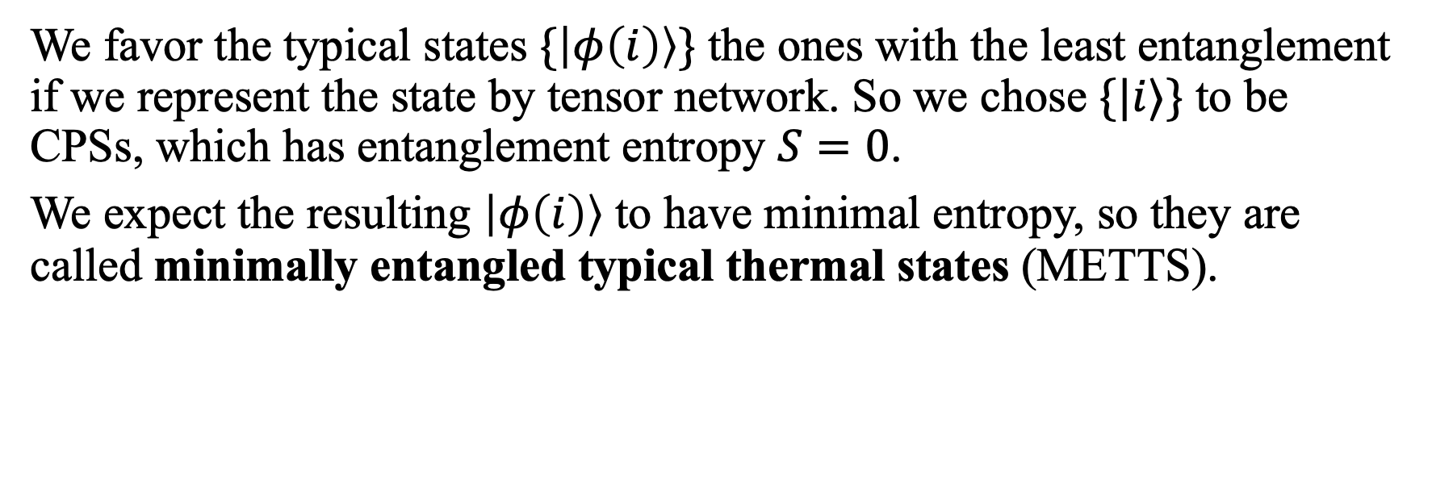
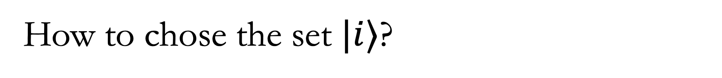
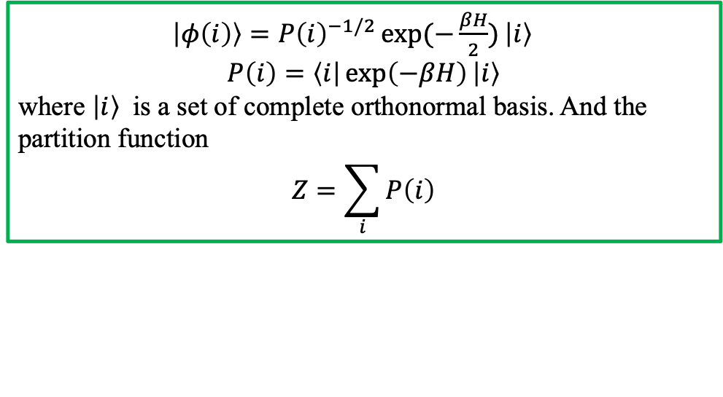
How to chose the set $|i⟩$?
$\left|φ\left(i\right)\right\rangle =P{\left(i\right)}^{−1/2}\exp{(−\frac{βH}{2})}\left|i\right\rangle$
$$P\left(i\right)=\left\langle i\right|\exp\left(−βH\right)\left|i\right\rangle$$
where $\left|i\right\rangle$ is a set of complete orthonormal basis. And the partition function
$$Z=\sum_{i}{P\left(i\right)}$$
We favor the typical states $\{\left|φ\left(i\right)\right\rangle \}$ the ones with the least entanglement if we represent the state by tensor network. So we chose $\{|i⟩\}$ to be CPSs, which has entanglement entropy $S=0$.
We expect the resulting $\left|φ\left(i\right)\right\rangle$ to have minimal entropy, so they are called minimally entangled typical thermal states (METTS).

Slide 5
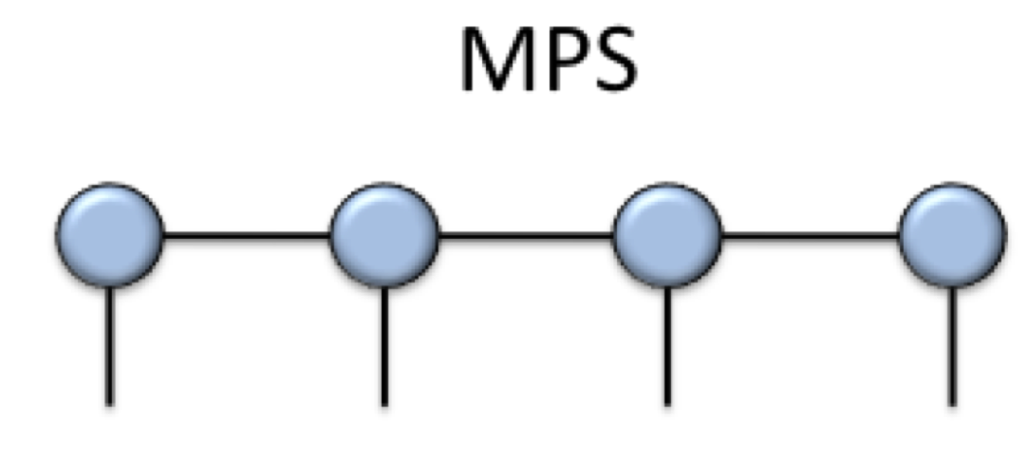
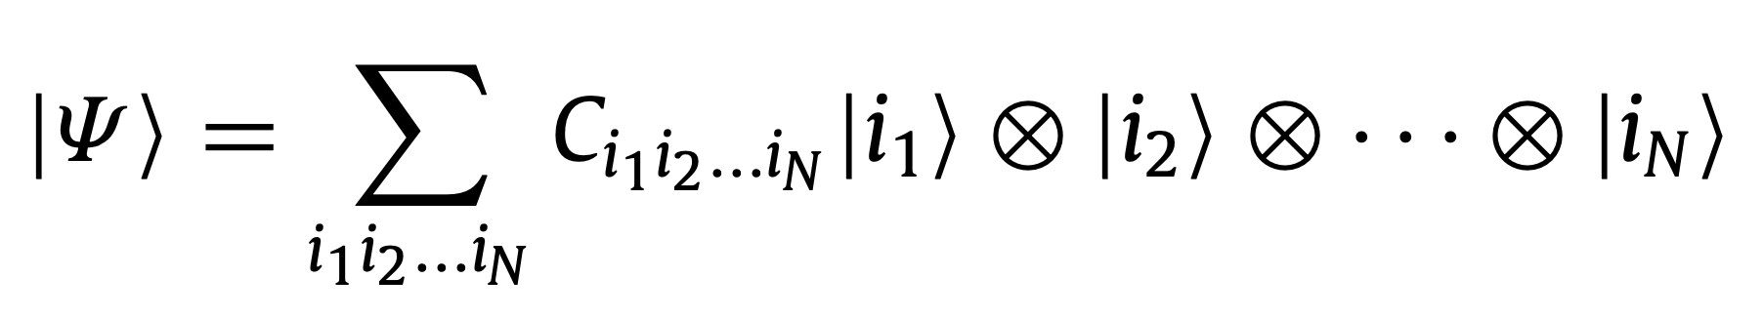
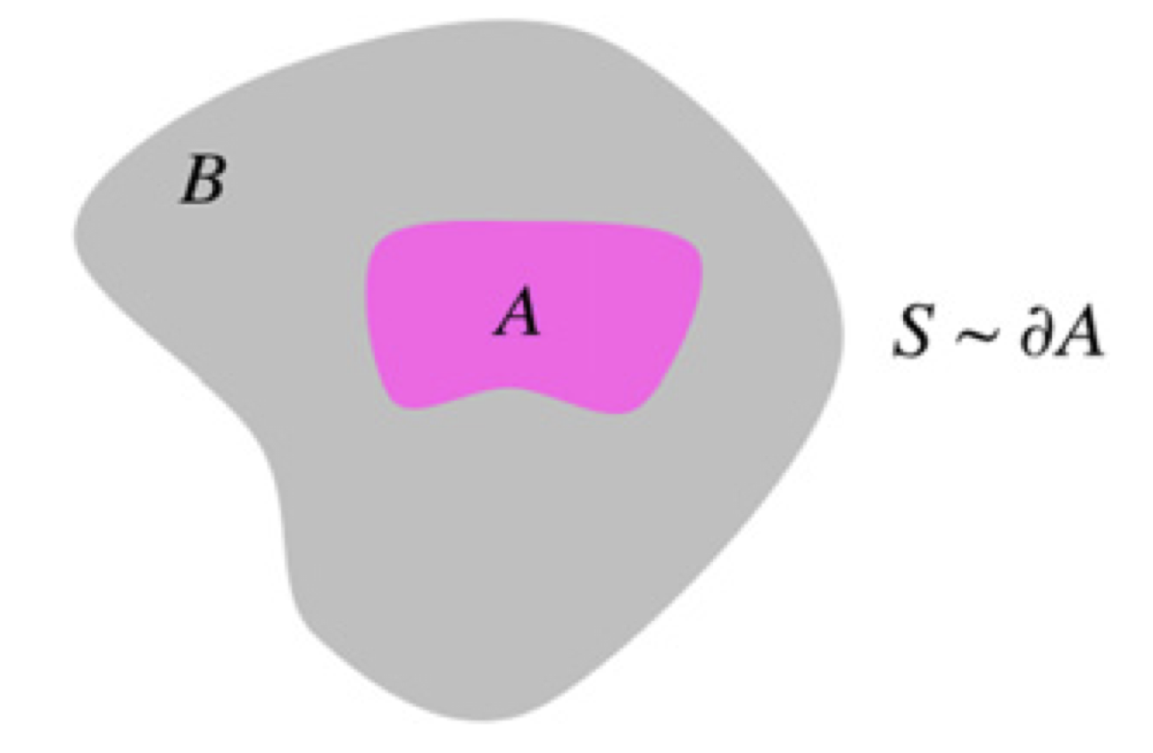
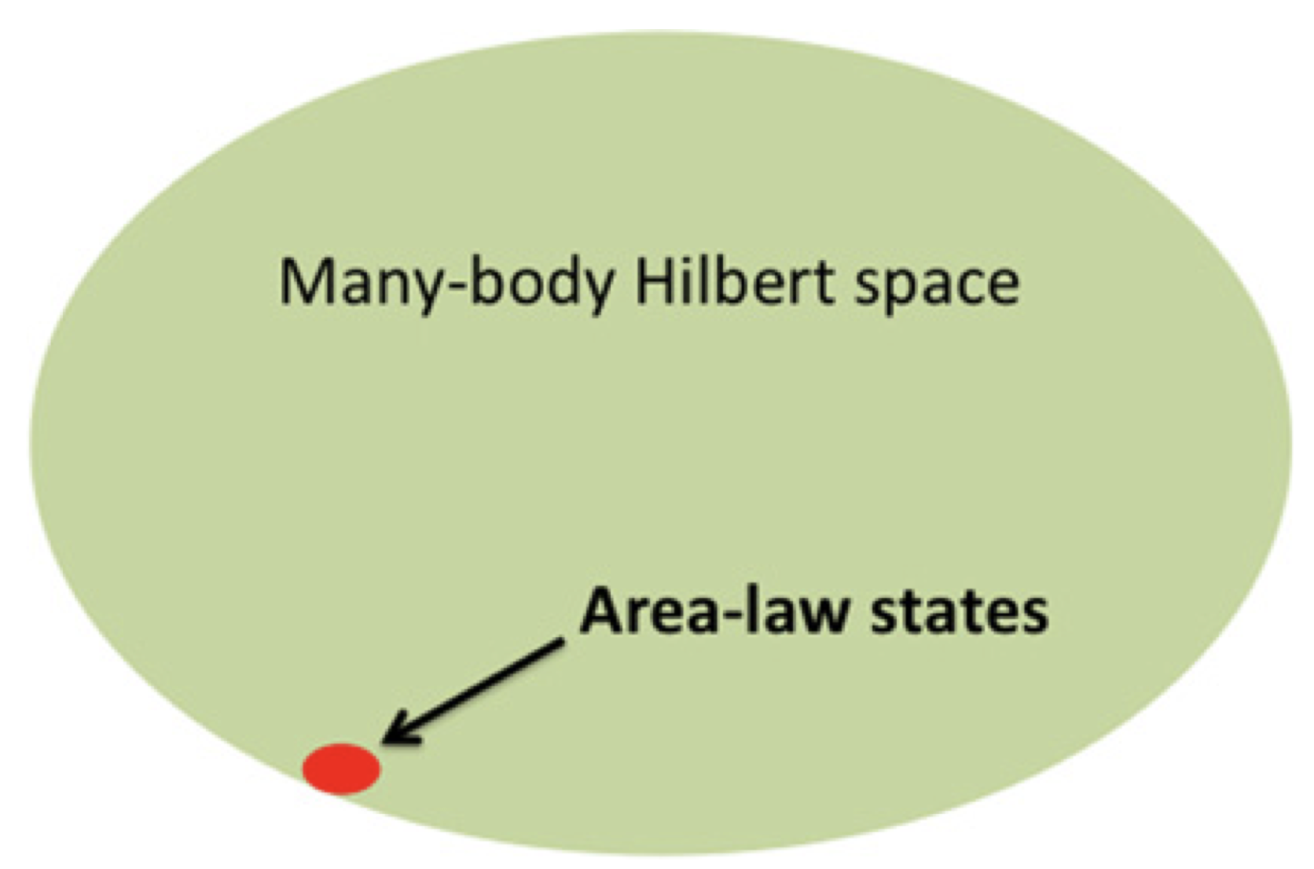
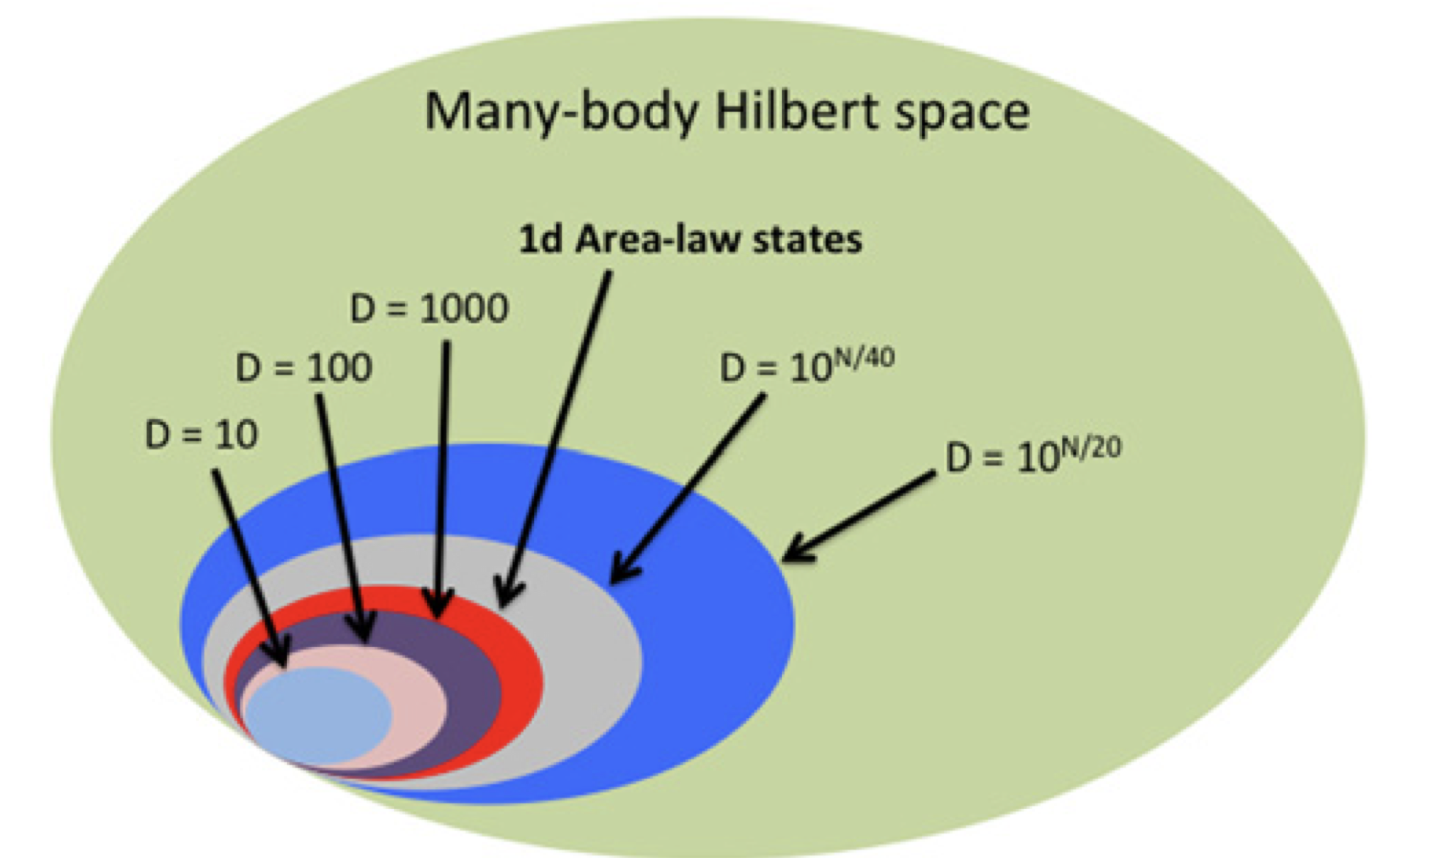
A short review for matrix product state (MPS) and its time evolution
Roman Orus, A practical introduction to tensor networks: Matrix product states and projected entangled pair states, Annals of Physics, 2014
entanglement area law
The Hilbert space is far too large, but the physical ground state only corresponds to a tiny corner.
MPS with finite bond dimension reproduce the properties of the corner of the Hilbert space satisfying the 1d area-law for the entanglement entropy.
Notes:
这里可以板书一下这个tensor decomposition.
也需要解释一下MPS 的area law

Slide 6
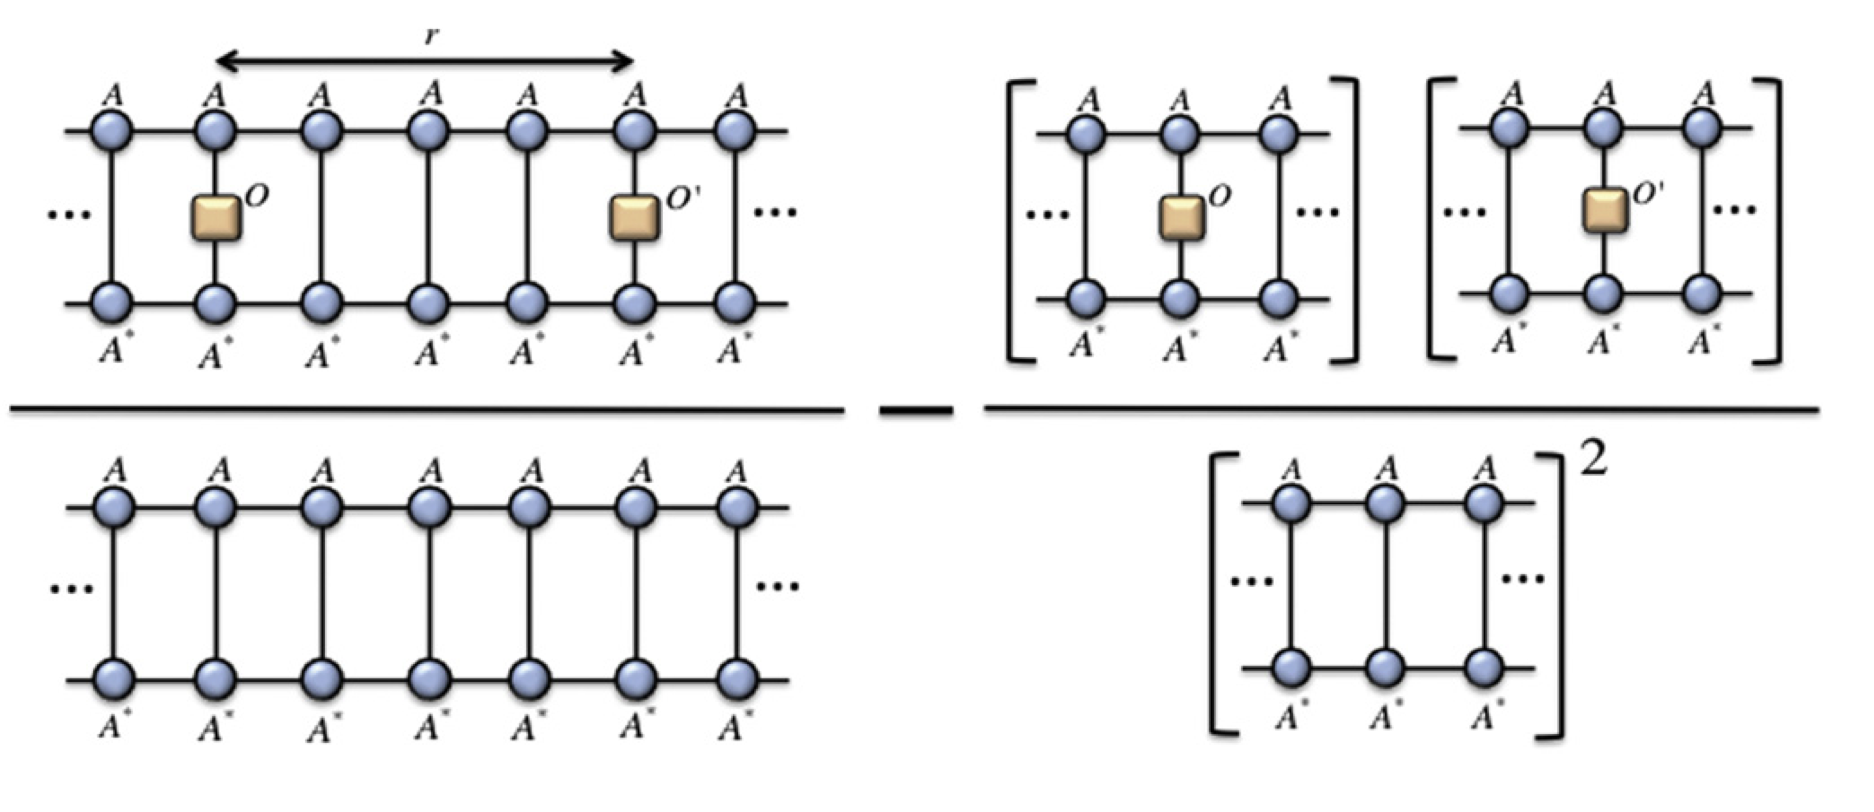
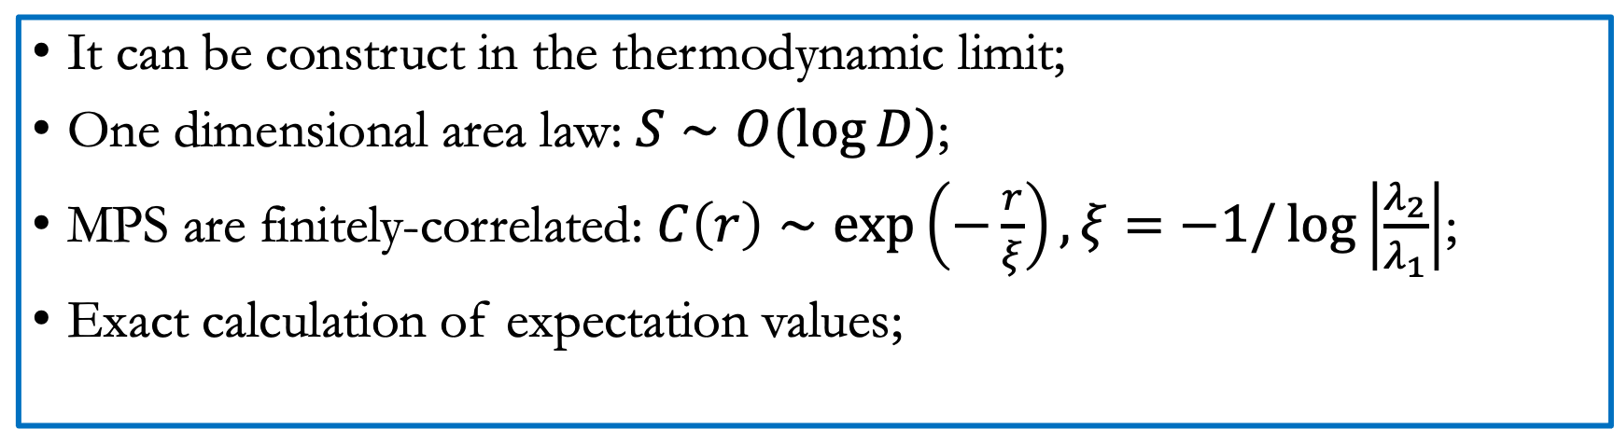
Some properties of MPS
It can be construct in the thermodynamic limit;
One dimensional area law: $S∼O(\log{D})$;
MPS are finitely-correlated: $C\left(r\right)∼\exp\left(−\frac{r}{ξ}\right), ξ=−1/\log\left|\frac{λ_{2}}{λ_{1}}\right|$;
Exact calculation of expectation values;
$$C\left(r\right)=\left\langle O\left(0\right)O^{′}\left(r\right)\right\rangle −\left\langle O\left(0\right)\right\rangle \left\langle O^{′}\left(r\right)\right\rangle =$$

Slide 7
Time evolution

Slide 8
Another question: how to construct the Marc

